Slide 1
Exploratory Project
Humanoid Control using Human Pose Estimation
Supervisor : Prof. Satyabrata Jit
Group Members:
S Niranth Sai (18095074)
Nishant Kumar (18095048)
Piyush Sharan (18095087)

Slide 2
Applications -
Military – Unmanned Army, bots etc.
Character Animation – Current systems rely on marks and special suits and need multiple cameras & sensors. With this new kind of pose estimation we could do it theoretically with just one camera !
Video Gaming – Your avatar in game moves as you move in the real world !
Can be used for sign language detection, Video Survaillance, etc.

Slide 3
Introduction
Manually controlling a humanoid robot is a strenuous task. As there are so many joints, it becomes difficult to control them all at once.
Motion Capture techniques for tracking human movement work but they are difficult to set up, expensive, involve various sensors, etc.
We propose using a Computer Vision model PoseNet to detect human posture from an image. This posture is used by the robot to adjust its position so as to match the human posture from the image
The project can be divided into three parts:
Capturing pose from an RGB image using PoseNet.
Extracting angles from key points given by PoseNet.
Feeding calculated angles into our humanoid robot in PyBullet Physics Engine

Slide 4
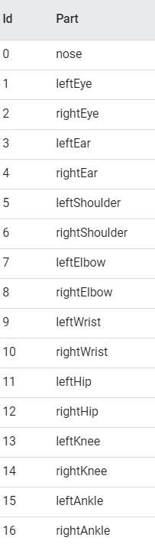
1. Capturing pose from an RGB image using PoseNet
We used PoseNet, a Convolutional Neural Network model that can be used to estimate the pose of a person in an image or video by estimating where key body joints are.
PoseNet outputs 17 body parts and the parts are chained in a graph.
At a high-level pose estimation happens in two phases:
An input RGB image is fed through a convolutional neural network.
An algorithm is used to decode poses, pose confidence scores, keypoint positions, and keypoint confidence scores from the model outputs.

Slide 5
Pose
At the highest level, PoseNet will return a pose object that contains a list of key-points and an instance-level confidence score for each detected person.
Pose confidence score — this determines the overall confidence in the estimation of a pose. It ranges between 0.0 and 1.0. It can be used to hide poses that are not deemed strong enough.
Keypoint — a part of a person’s pose that is estimated, such as the nose, right ear, left knee, right foot, etc. It contains both a position and a keypoint confidence score. PoseNet currently detects 17 key-points
Keypoint Confidence Score — this determines the confidence that an estimated keypoint position is accurate. It ranges between 0.0 and 1.0. It can be used to hide key points that are not deemed strong enough.
Keypoint Position — 2D x and y coordinates in the original input image where a key-point has been detected.

Slide 6

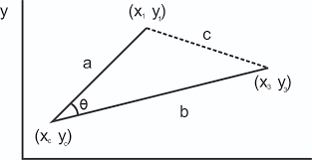
2. Extracting angles from key-points given by PoseNet
The key points given by our PoseNet are used to calculate different joint angles.
The angle between three points can be calculated using coordinate geometry by finding slopes of the two lines formed and finding the angles between them. (Fig-1)
Directly calculated angles between
points would not help here as each
joint angle for the robot is to be given
with respect to a different frame. So
each individual angle was scaled
according to the robot frame.
Fig - 1 Fig - 2
(Fig-1)

Slide 7
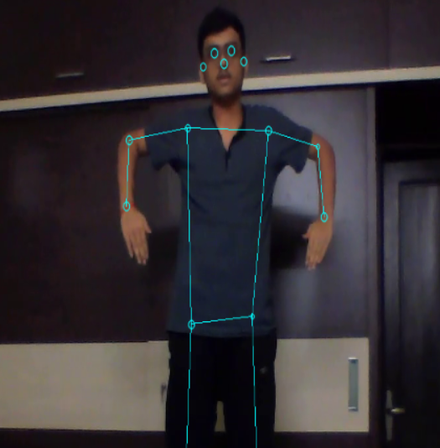
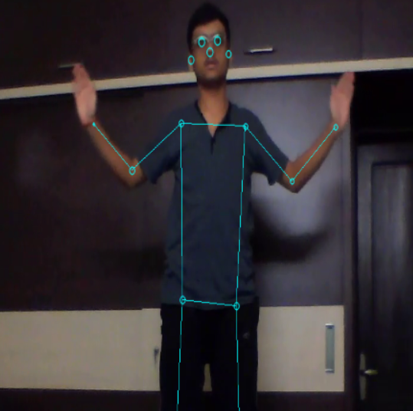
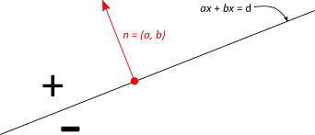
There were some cases when the angle was the same for different poses as shown in the Fig - 2
For this case, we used the line joining
shoulder to elbow joint as a reference line.
By substituting the position of the wrist
in the above line equation,we find to
which side of the line is our wrist present.
By substituting points lying above the line in the line equation, we get a positive value.
By substituting points lying below the line in
the line equation, we get a negative value.
(Fig-2)-Angle made at elbow is the same for both cases

Slide 8
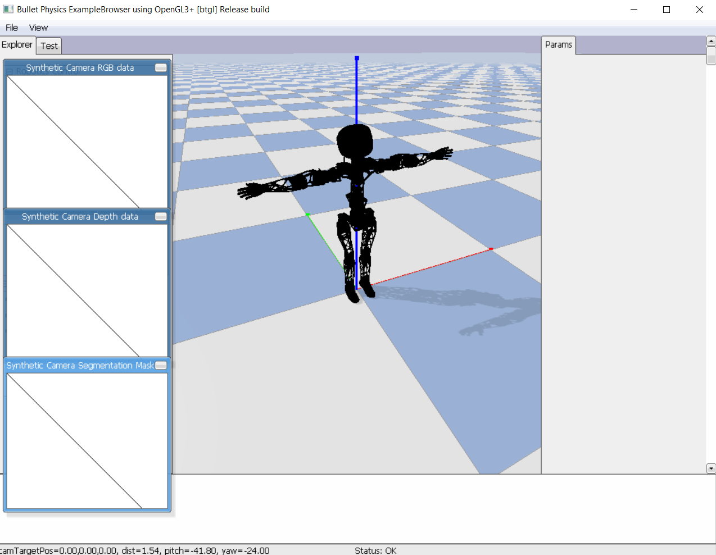
3. Feeding calculated angles into PyBullet Physics Engine:
PyBullet is a Python module for robotics simulation and machine learning, with a focus on simulation-to-real transfer.
A simulation in the Bullet physics engine can be easily brought into the real world with some minor tweaks.
URDF file of Poppy humanoid robot was used in the simulator as it is free, easy to use, and can be easily brought into real-world by 3D printing the STL files of robot parts.
The angles were scaled accordingly so as to work with humanoid and are used in the ‘setJointMotorControl2’ function of PyBullet to control the joints of the robot by setting desired control mode and position/force/torque.

Slide 9
Demo
(Video plays during slideshow)
Video Demo: https://drive.google.com/file/d/1PMeE-UpXgCeP0Dca3F1I_jvnYpxc2cBa/view?usp=sharing

Slide 10
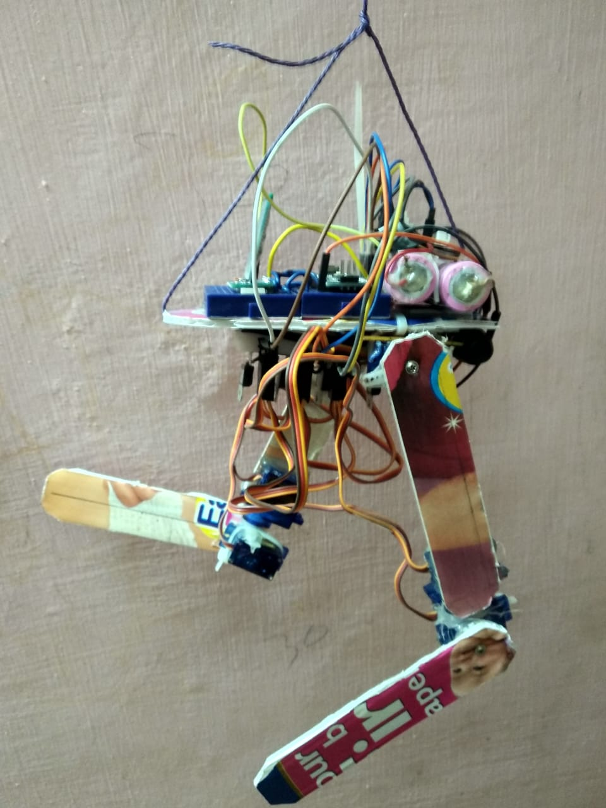
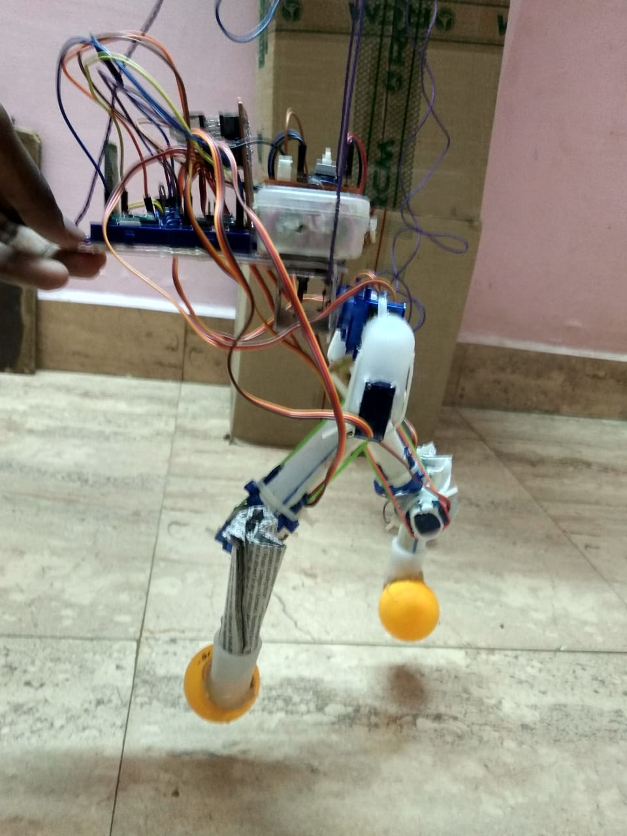
HardWare
Our primary aim was to deploy our idea in a real-world robot and validate its performance. Unfortunately, we were not able to do it due to the pandemic situation.
Fig-5 and Fig-6 are our first and second prototypes of the robot which we thought of using initially
(Fig-5) (Fig-6)

Slide 11
Future Scope
Our Bot’s movement currently is limited to a plane, using 3D PoseNet, the Bot will be able to move in all directions. But, due to computational limitations, we were not able to use 3D PoseNet.
Keeping a separate PID controller to balance the robot in all directions would make it more robust.
Conclusion
We show the robustness and scalability of our idea by validating our results in the Pybullet physics engine. We are confident that it could be readily transferred to a real-life robot as we experimented with the 3d model of a prefabricated real-world Humanoid robot named Poppy.
Our project repository: https://github.com/nishantkr18/Humanoid-controller-using-pose-estimation
Video Demo: https://drive.google.com/file/d/1PMeE-UpXgCeP0Dca3F1I_jvnYpxc2cBa/view?usp=sharing

